Slide 1

Advance CSS

Slide 2
Prerequisites
Basic idea about web development
Knowledge about HTML
Basic CSS

Slide 3
Learning Objective
Rounded Corners Gradients Shadows Transitions | Object Fit Object Position Buttons Media Queries

Slide 4
Rounded Corners
Rounded corners in CSS are a way to soften the edges of elements, making them appear less angular and more visually pleasing.
border-radius: 15px;
border-radius: 50px / 15px;
border-radius: 15px / 50px;
border-top-left-radius: 10px;
border-top-right-radius: 20px;
border-bottom-left-radius: 5px;
border-bottom-right-radius: 15px;
border-radius: 50%;

Slide 5
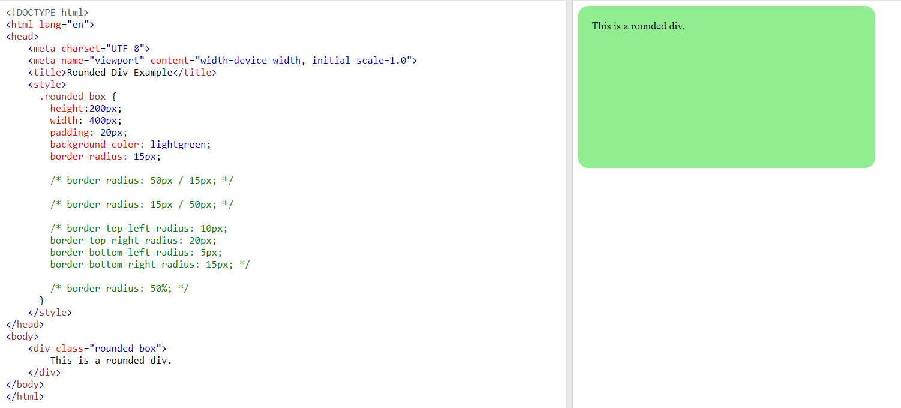

Slide 6
Gradients
CSS gradients allow you to create smooth transitions between two or more colors. Gradients are useful for adding depth, dimension, and visual interest to elements on a webpage.
There are two main types of gradients in CSS:
Linear Gradients
Radial Gradients

Slide 7
Gradients
Horizontal Linear Gradient
.linear-horizontal {
background: linear-gradient(to right, #ff0000, #0000ff);
}
Vertical Linear Gradient
.linear-vertical {
background: linear-gradient(to bottom, #00ff00, #ffff00);
}

Slide 8
Gradients
Diagonal Linear Gradient
.linear-diagonal {
background: linear-gradient(to bottom right, #ff00ff, #000000);
}
Custom Angle Linear Gradient
.linear-angle {
background: linear-gradient(135deg, #ff6600, #0099cc);
}

Slide 9
Gradients
Circular Radial Gradient
.radial-circular {
background: radial-gradient(circle, #ffcc00, #ff0000);
}
Elliptical Radial Gradient
.radial-elliptical {
background: radial-gradient(ellipse, #00ccff, #ff33cc);
}

Slide 10
Gradients
Custom Shape Radial Gradient
.radial-custom {
background: radial-gradient(at top right, #00ff99, #9966ff);
}

Slide 11
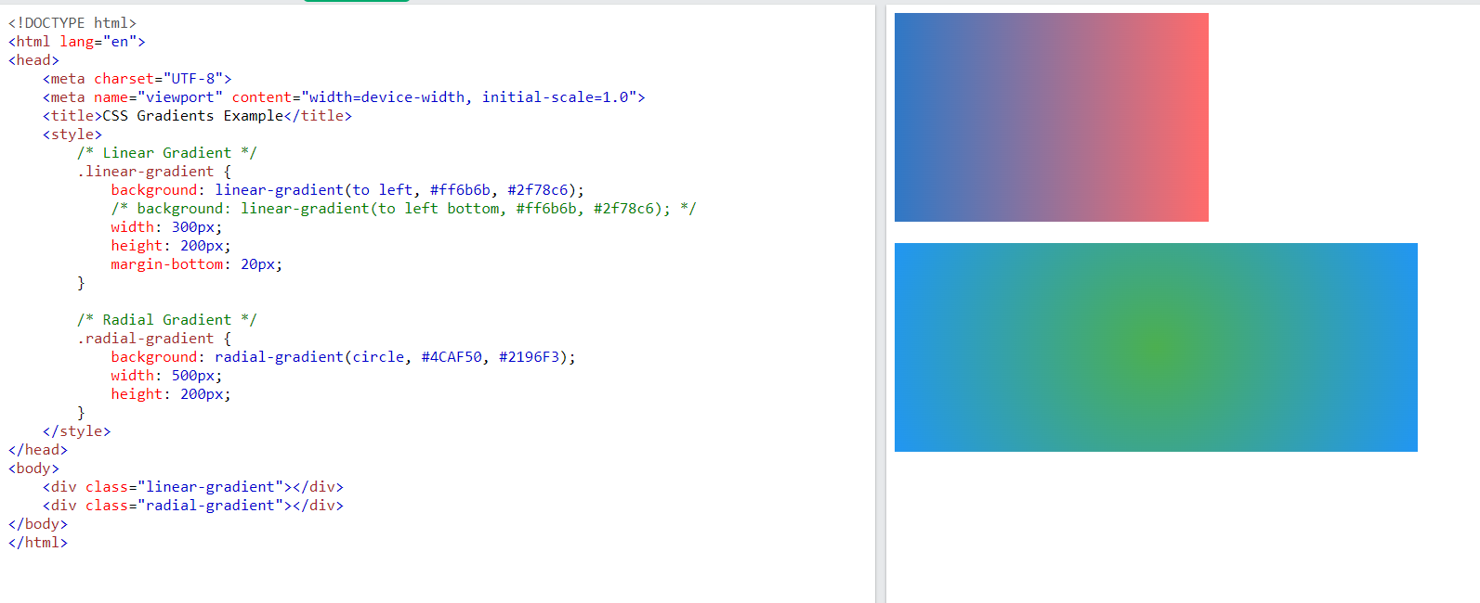

Slide 12
Shadows
CSS shadows are a powerful way to add depth and dimension to elements on a webpage. There are two main types of shadows in CSS:
Box Shadows
Text Shadows

Slide 13
Shadows
Basic Box Shadow
.box-shadow {
box-shadow: 5px 5px 10px rgba(0, 0, 0, 0.3);
box-shadow: inset 10px 10px 20px rgba(0, 0, 0, 0.5);
}
Text Shadow
.text-shadow {
text-shadow: 2px 2px 4px rgba(0, 0, 0, 0.5);
}

Slide 14
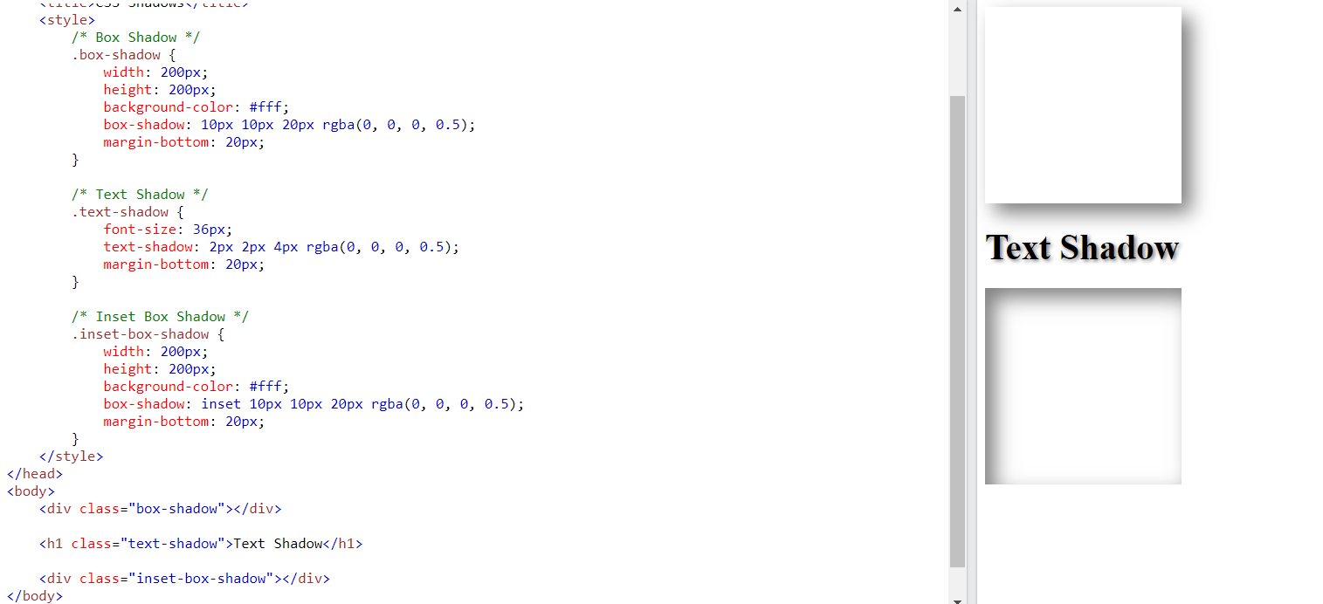

Slide 15
Transition
CSS transitions allow you to smoothly animate the transition of CSS properties over a specified duration.
div {
width: 100px;
height: 100px;
background: red;
transition: width 2s;
/* transition: width 2s, height 4s; */
/* transition-delay: 1s; */
}
div:hover { width: 300px;
/*height: 300px;*/ }

Slide 16
Transition
div {
width: 100px;
height: 100px;
background: red;
transition-property: width;
transition-duration: 2s;
transition-timing-function: linear; /*ease, ease-in, ease-out, */
transition-delay: 1s;
}
div:hover {
width: 300px;
height: 300px;
transform: rotate(180deg);
}

Slide 17
Transition
div {
width: 100px;
height: 100px;
background: red;
transition: width 2s linear 1s;
}
div:hover {
width: 300px;
}

Slide 18
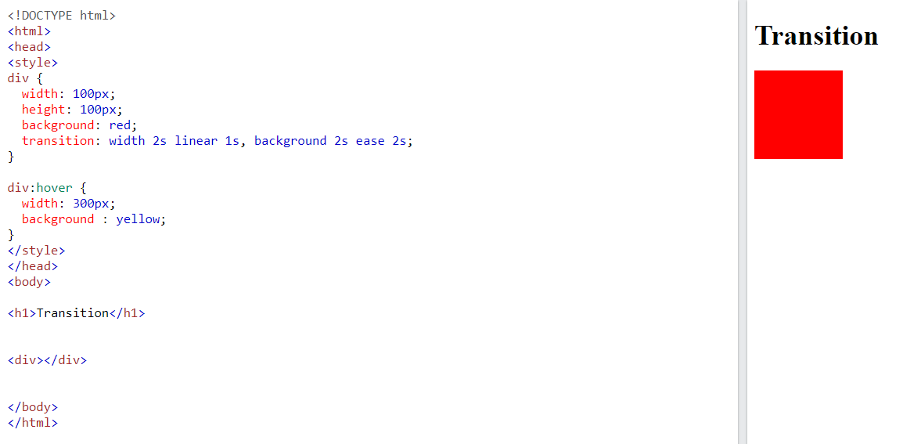

Slide 19
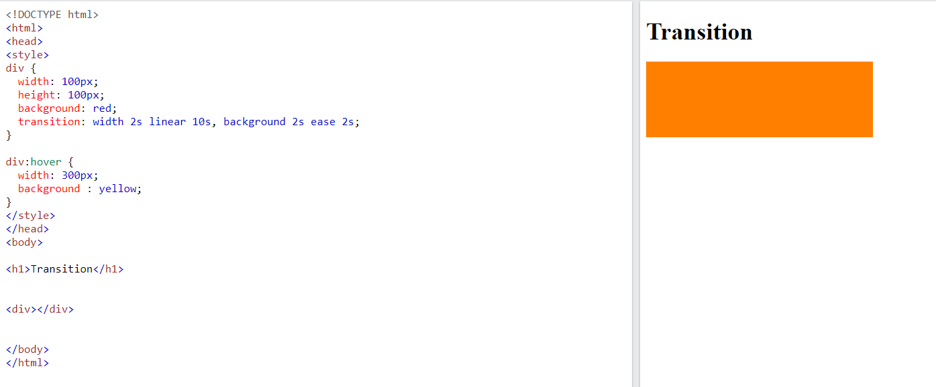

Slide 20
Object Fit
object-fit is a CSS property used to specify how an <img> or <video> element should be resized to fit its content box. It allows you to control how the content of the element is scaled and positioned within its container.
img {
width: 200px; /* Set a fixed width */
height: 150px; /* Set a fixed height */
object-fit: cover; /* Apply the cover value */
}

Slide 21
Object Fit
This is default. The image is resized to fill the given dimension. If necessary, the image will be stretched or squished to fit
.fill {object-fit: fill;}
The image keeps its aspect ratio, but is resized to fit within the given dimension
.contain {object-fit: contain;}
The image keeps its aspect ratio and fills the given dimension. The image will be clipped to fit
.cover {object-fit: cover;}
The image is not resized
.none {object-fit: none;}
The image is scaled down to the smallest version of none or contain
.scale-down {object-fit: scale-down;}

Slide 22
Object Position
The object-position property in CSS allows you to specify the alignment of the replaced element (like an image or a video) inside its containing box.
img {
width: 200px; /* Set a fixed width */
height: 150px; /* Set a fixed height */
object-fit: cover; /* Apply the cover value */
object-position: 80% 100%;
}

Slide 23
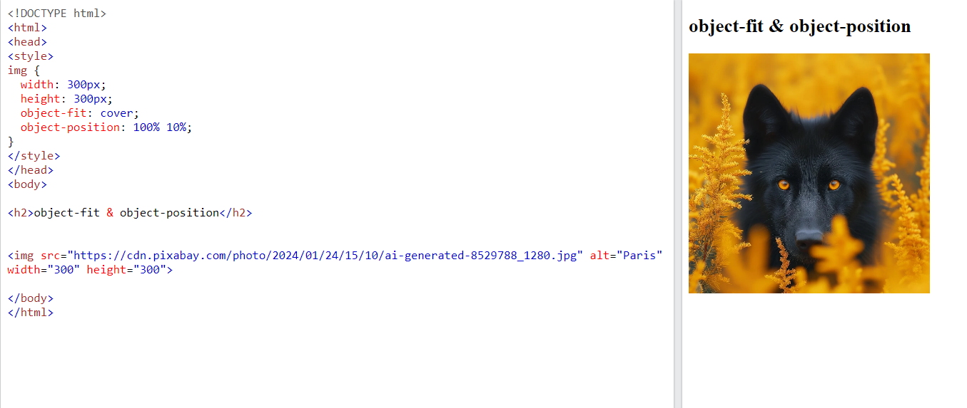

Slide 24
Buttons
Creating CSS buttons allows you to style HTML buttons to match the design of your website.
.button {
background-color: #04AA6D; /* Green */
border: none;
color: white;
padding: 16px 32px;
text-align: center;
text-decoration: none;
display: inline-block;
font-size: 16px;
margin: 4px 2px;
transition-duration: 0.4s;
cursor: pointer;
}

Slide 25
Buttons
.button1 {
background-color: white;
color: black;
border: 2px solid #04AA6D;
}
.button2 {
background-color: white;
color: black;
border: 2px solid #008CBA;
}

Slide 26
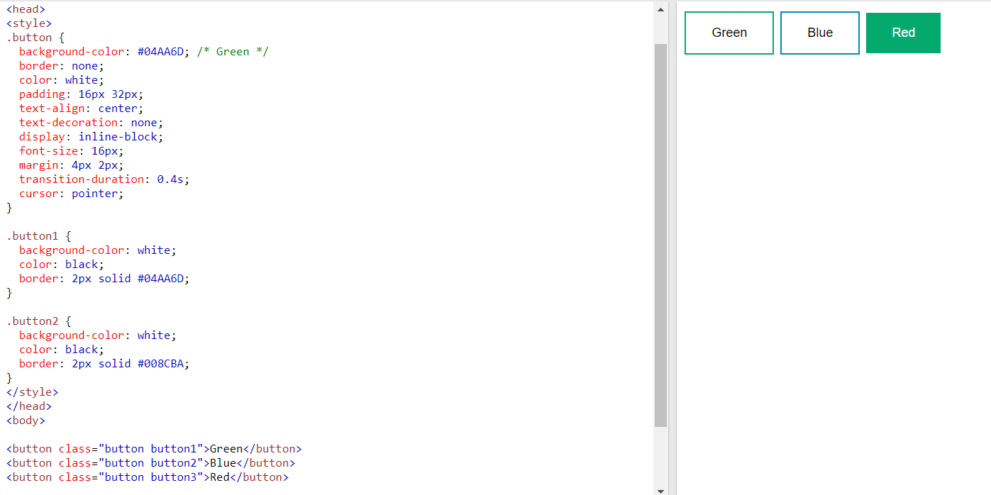

Slide 27
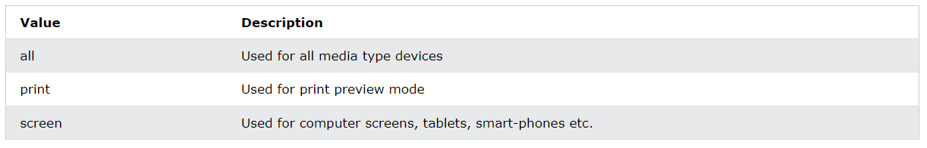
Media Queries
CSS media queries allow you to apply different styles to your webpage based on various factors such as screen size, device orientation, or other media features. This feature is particularly useful for creating responsive web designs that adapt to different devices and screen sizes.
Media Types

Slide 28
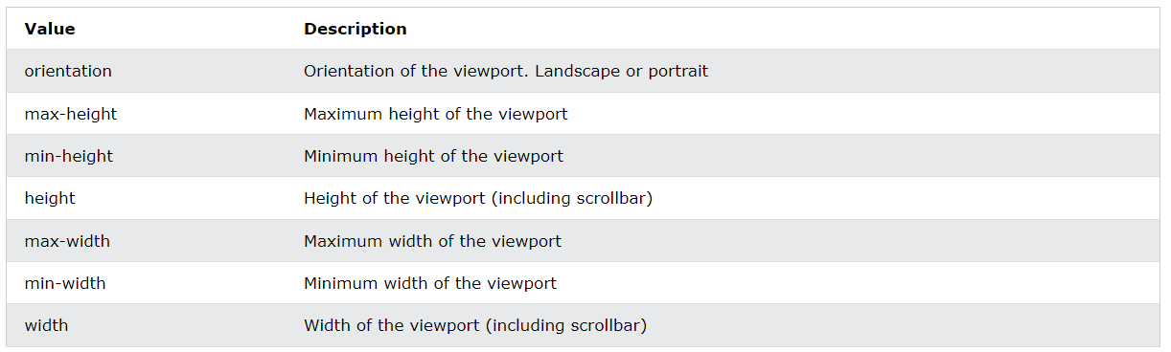
Media Queries
Common Media Feature

Slide 29
Media Queries
Media Query Syntax
@media not|only mediatype and (media feature) and (media feature) { CSS-Code; }
Meaning of the not, only, and and keywords:
not: This keyword inverts the meaning of an entire media query.
only: This keyword prevents older browsers that do not support media queries from applying the specified styles. It has no effect on modern browsers.
and: This keyword combines a media type and one or more media features.

Slide 30
Media Queries
Media Query Syntax
@media not|only mediatype and (media feature) and (media feature) { CSS-Code; }
Meaning of the not, only, and and keywords:
not: This keyword inverts the meaning of an entire media query.
only: This keyword prevents older browsers that do not support media queries from applying the specified styles. It has no effect on modern browsers.
and: This keyword combines a media type and one or more media features.

Slide 31
Media Queries
body {
font-size: 16px;
color: #333;
}
Media query for screens smaller than 768px
@media screen and (max-width: 768px) {
body {
font-size: 14px;
}
}

Slide 32
Media Queries
Media query for screens between 768px and 1024px
@media screen and (min-width: 768px) and (max-width: 1024px) {
body {
font-size: 18px;
}
}
Media query for screens larger than 1024px
@media screen and (min-width: 1025px) {
body {
font-size: 20px;
}
}

Slide 33
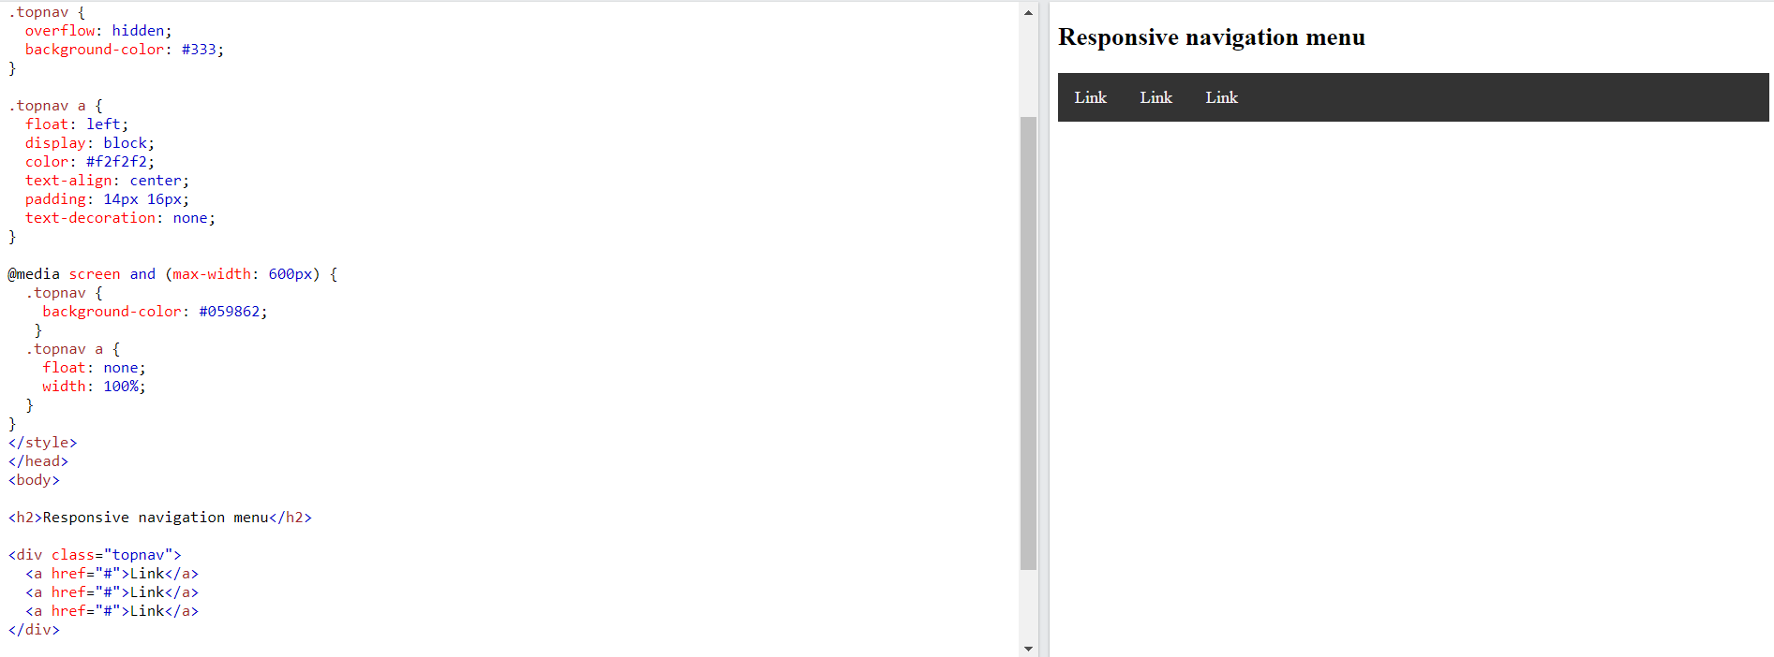

Slide 34
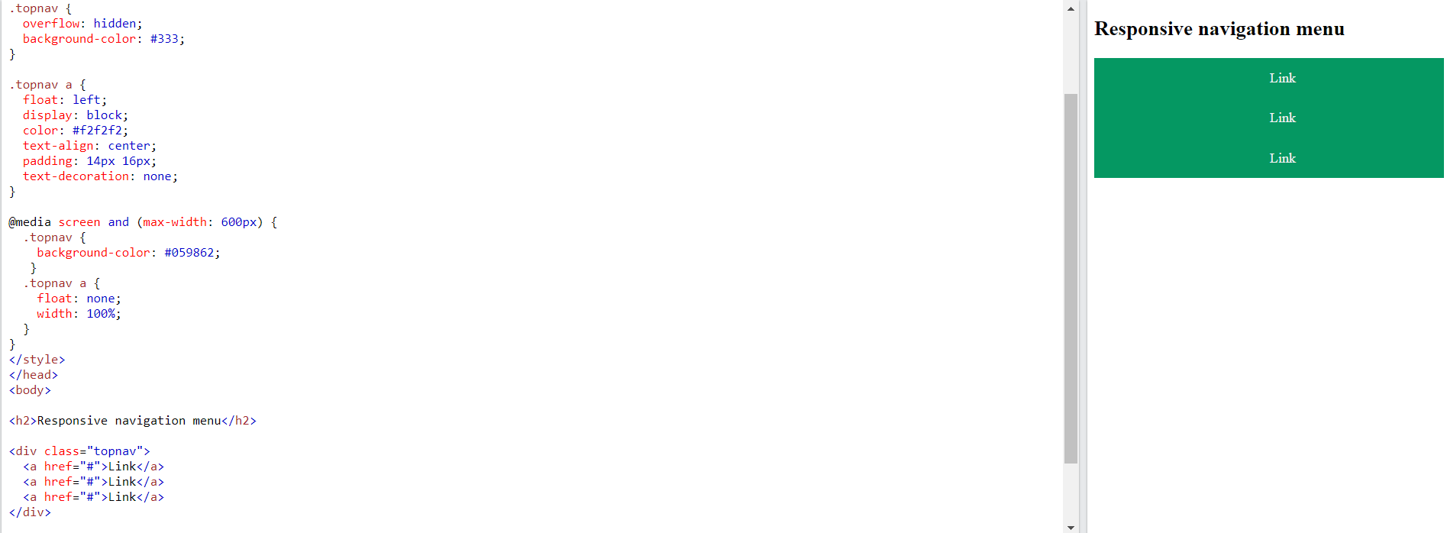

Slide 35
Thank you

